Slide 1

Real time Age and Gender Classification System
PRESENTED BY
Name: Divya Singireddy
Student ID: 811295900

Slide 2
INTRODUCTION
This project explores the intersection of deep learning and computer vision to develop an innovative system capable of real-time age and gender classification. With applications spanning various domains, such as retail, security, personalized marketing, and social analytics, the system aims to provide accurate and efficient predictions of an individual's age and gender based on facial images. The project leverages the "UTKFace dataset", a widely recognized dataset sourced from Kaggle, which comprises a diverse collection of labeled facial images. These images include annotations for age, gender, and ethnicity, making the dataset well-suited for training deep learning models to classify age and gender while addressing real-world diversity challenges.

Slide 3
Objectives
Develop a real-time system for predicting age and gender.
1
Utilize the UTKFace dataset for training and validation.
2
Optimize the model for accuracy and speed.
3
Demonstrate applications in various domains like retail, security, and analytics.
4

Slide 4
Methodology
1. Data Preprocessing:
Handle diverse image formats and resolutions.
Perform data augmentation to improve model robustness.
2. Model Development:
Use convolutional neural networks (CNNs) for feature extraction.
Train the model using the UTKFace dataset.
3. Deployment:
Optimize for lightweight deployment.
Implement real-time predictions using OpenCV.

Slide 5
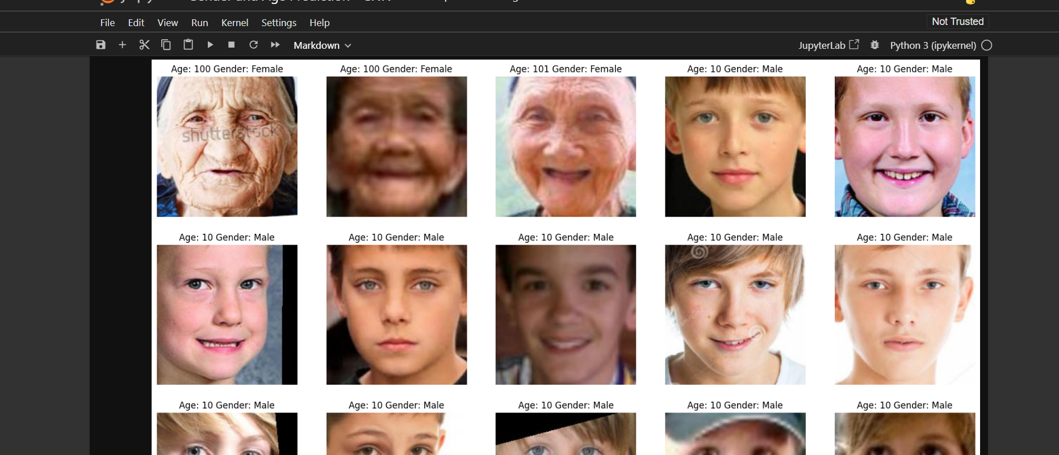
DATASET
Below is the dataset that I've used in developing this application,

Slide 6
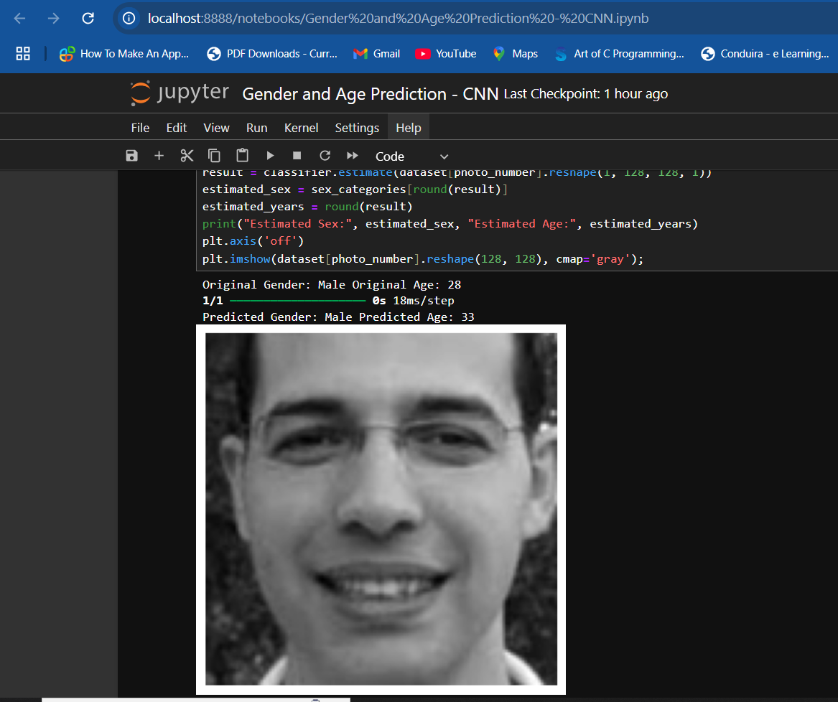
RESULTS
I have performed testing on a test image.We can observe in the below screenshot that the system accurately identifies the gender and age of the image given.

Slide 7
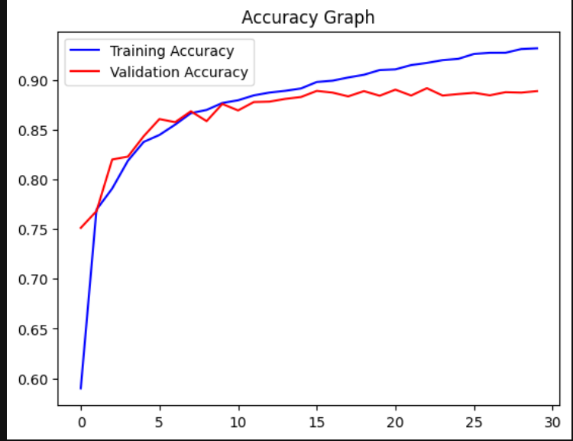
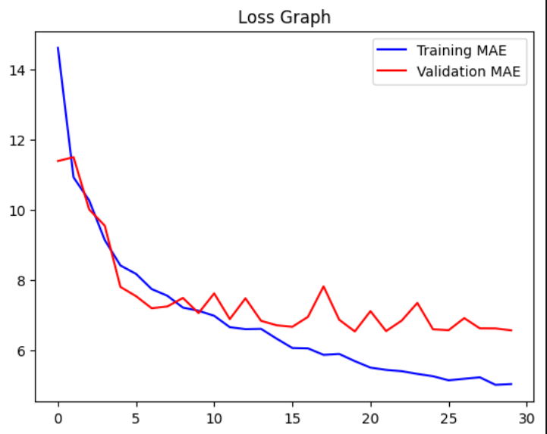
EVALUATION

Slide 8
Challenges and Solutions
Handling imbalanced data: Resampling techniques and data augmentation.
Achieving real-time performance: Model optimization and quantization.
Addressing biases: Dataset analysis and mitigation strategies.

Slide 9
Applications
Retail: Personalized marketing and customer analytics.
Security: Enhanced surveillance systems.
Healthcare: Patient monitoring and demographic studies.
Education: Tailored learning experiences.

Slide 10
CONCLUSION
The real-time age and gender classification project leverages deep learning and the UTKFace dataset to predict demographic attributes with high accuracy and efficiency. Using CNN-based modeling and OpenCV, the system enables seamless real-time predictions, addressing challenges like data imbalance and diverse facial attributes. It lays the groundwork for future advancements, including adding more attributes, bias mitigation, and edge device optimization, showcasing AI's potential in demographic analysis for industries like security, marketing, and healthcare.

Slide 11
Future Work
Expand
Expand to additional demographic attributes like ethnicity.
Integrate
Integrate emotion detection for comprehensive analysis.
Deploy on
Deploy on edge devices for enhanced portability.
Collaborate
Collaborate with industries for practical applications.

Slide 12

THANK YOU !

